Slide 1

Internet Programming I
Chapter 4
JavaScript: Objects
Group: 6
3rd Year Sec D Students,
Dept. of Software Eng.
Jan 2022, AASTU

Slide 2

Objectives
After success completion of the session you will be able to:
Define what is object
How to create object in different ways
Differentiate what is property and method
Define what is contractor and prototype
List and discuss built-in objects in javascript
Discuss how to traverse objects in javascript
Define what is inheritance

Slide 3
Outline
Javascript object and inheritance
JS Object concept
Object Creation options
Object properties and methods
Object accessors
Object constructors and prototype
Traverse objects
Inheritance

Slide 4
Object concept
object can be a variable, a data structure, a function, or a method. As regions of memory, they contain value and are referenced by identifiers.
In the object-oriented programming paradigm, object can be a combination of variables, functions, and data structures; in particular in class-based variations of the paradigm it refers to a particular instance of a class.
In the relational model of database management, an object can be a table or column, or an association between data and a database entity (such as relating a person's age to a specific person).
An important distinction in programming languages is the difference between an object-oriented language and an object-based language. A language is usually considered object-based if it includes the basic capabilities for an object: identity, properties, and attributes. A language is considered object-oriented if it is object-based and also has the capability of polymorphism, inheritance, encapsulation, and, possibly, composition.
JavaScript is a prototype based object oriented language

Slide 5
Javascript Object concept
Objects, in JavaScript, is it’s most important data-type and forms the building blocks
for modern JavaScript. These objects are quite different from JavaScript’s primitive data-types(Number, String, Boolean, null, undefined and symbol) . in the sense that
while these primitive data-types all store a single value each (depending on their types).
Objects are more complex and each object may contain any combination of these primitive data-types as well as reference data-types.
An object, is a reference data type. Variables that are assigned a reference value are given a reference or a pointer to that value. That reference or pointer points to the location in memory where the object is stored. The variables don’t actually store the value.

Slide 6
Javascript Object concept
Loosely speaking, objects in JavaScript may be defined as an unordered collection of related data, of primitive or reference types, in the form of “key: value” pairs. These keys can be variables or functions and are called properties and methods, respectively, in the context of an object.

Slide 7
Javascript Object creating
1. Creating objects using object literal syntax
This is really simple. All you have to do is throw your key value pairs separated by ‘:’ inside a set of curly braces({ }) and your object is ready to be served (or consumed), like below:
const person = {
firstName: 'testFirstName',
lastName: 'testLastName'
};
This is the simplest and most popular way to create objects in JavaScript.

Slide 8
Javascript Object creating
2. Creating objects using the ‘new’ keyword
This method of object creation resembles the way objects are created in class-based languages, like Java.
a) Using the ‘new’ keyword with’ in-built Object constructor function
To create an object, use the new keyword with Object() constructor, like this:
const person = new Object();
Now, to add properties to this object, we have to do something like this:
person.firstName = 'testFirstName';
person.lastName = 'testLastName';

Slide 9
Javascript Object creating
b) Using ‘new’ with user defined constructor function
problem with the approach of using the ‘Object’ constructor function result from the fact that every time we create an object, we have to manually add the properties to the created object.so we use user defined constructor.
function Person(fname, lname) {
this.firstName = fname;
this.lastName = lname;
}
const personOne = new Person('testFirstNameOne', 'testLastNameOne');
const personTwo = new Person('testFirstNameTwo', 'testLastNameTwo');

Slide 10
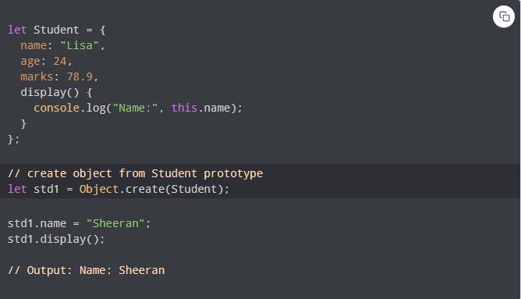
Javascript Object creating
3. Using Object.create() to create new objects
The Object.create() method creates a new object using the prototype of the given object.

Slide 11
Javascript Object creating
create() Syntax
The syntax of the create() method is:
const orgObject = { company: 'ABC Corp' };
And you want to create employees for this organization. Clearly, you want all the employee objects.
const employee = Object.create(orgObject, { name: { value: 'EmployeeOne' } });
console.log(employee); // { company: "ABC Corp" }
console.log(employee.name); // "EmployeeOne"

Slide 12
Javascript Object creating
4.Object.assign()
Object.assign method can take any number of objects as parameters. The first parameter is the object that it will create and return. The rest of the objects passed to it will be used to copy the properties into the new object. Let’s understand it by extending the previous example we saw.
Object.assign() is used for cloning an object.
Object.assign() is used to merge object with same properties.

Slide 13
Javascript Object creating
Assume you have two objects as below:
const orgObject = { company: 'ABC Corp' }
const carObject = { carName: 'Ford' }
Now, you want an employee object of ‘ABC Corp’ who drives a ‘Ford’ car. You can do that with the help of Object.assign as below:
const employee = Object.assign({}, orgObject, carObject);
Now, you get an employee object that has company and carName as its property.
console.log(employee); // { carName: "Ford", company: "ABC Corp" }

Slide 14
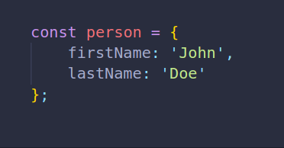
Object properties and methods
Object Properties
In JavaScript, an object is a collection of properties, where each property is a key-value pair.
This Example creates a new object called person using an object initializer.
The person object has two properties firstName and lastName.

Slide 15

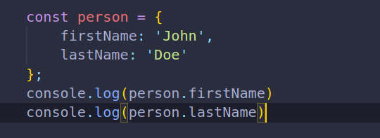
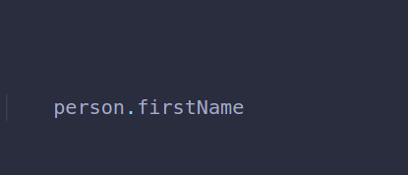
Object properties and methods
Manipulating Properties of an Object
Properties can usually be changed, added, and deleted, but some are read only.
Accessing Properties
To access the properties of the object we can use
Dot property accessor
expression should evaluate to an object, and identifier is the name of the property you'd like to access.
A common way to access the property of an object is the dot property accessor
For example to access the firstName property of the person object, you use the following expression:

Slide 16
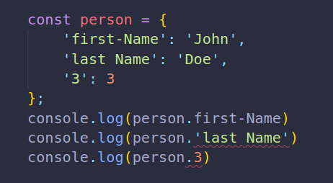
Object properties and methods cont…
You can use the dot property accessor in a chain to access deeper properties: object.prop1.prop2.
Choose the dot property accessor when the property name is known ahead of time.
The dot property accessor works correctly when the property name is a valid identifier.
An identifier in JavaScript contains Unicode letters, $, _, and digits 0..9, but cannot start with a digit.

Slide 17
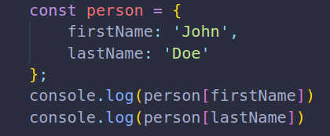
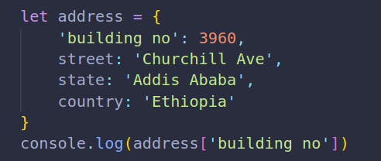
Object properties and methods cont…
2. Square brackets property accessor ([ ])
The square brackets property accessor has the following syntax:
expression[expression]
The first expression should evaluate to an object and the second expression should evaluate to a string denoting the property name.
when a property name contains spaces, you need to place it inside quotes

Slide 18
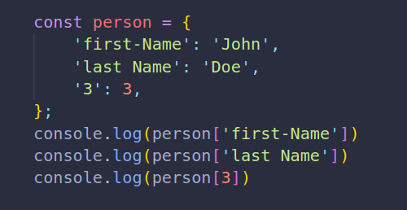
Object properties and methods cont…
To access the properties with these special names, use the square brackets property accessor
The square brackets syntax accesses without problems the properties that have special names
3. Object destructuring
The basic object destructuring syntax is pretty simple:
const { identifier } = expression;
identifier is the name of the property to access and expression should evaluate to an object.
Reading Assignment
https://dmitripavlutin.com/access-object-properties-javascript/

Slide 19
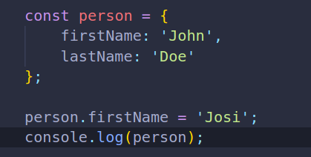
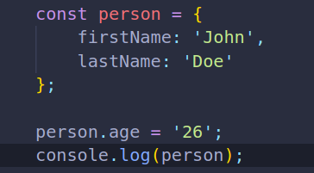
Object properties and methods cont…
B. Change the Property’s value
To change the value of a property, you use the assignment operator
C. Add a new property to an object
Unlike objects in other programming languages such as Java and C#, you can add property to an object after creating it
Output:
Output:

Slide 20
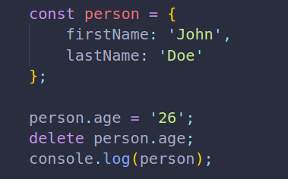
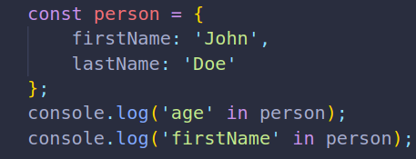

Object properties and methods cont…
D. Delete a property of an object
To delete a property from an object, you use the delete operator
E. Check if a property exists
To check if a property exists in an object, you use the in operator
Output:
Output:

Slide 21
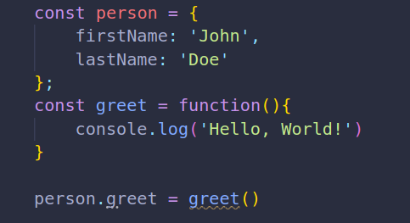
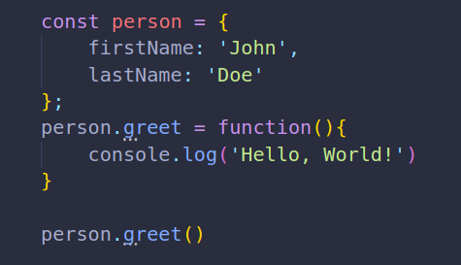
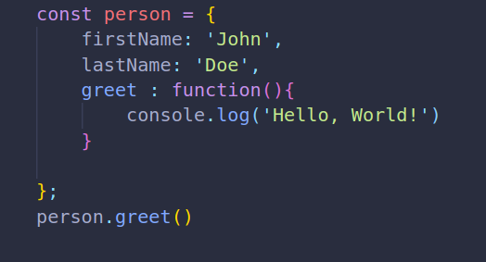
Object properties and methods cont…
Object Methods
Objects have actions. The actions are represented by functions. the following snippet adds the greet action to the person object

Slide 22
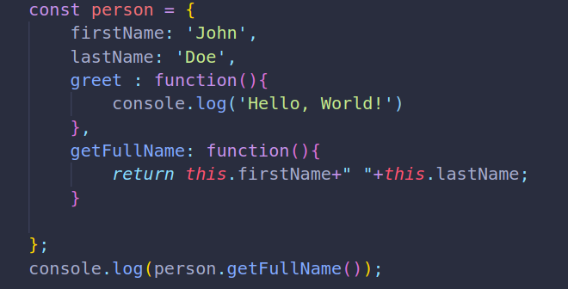

Object properties and methods cont…
The this value
Typically, methods need to access data stored in the object.
For example you want to develop a method that returns the full name of the person object by concatenating the first name and last name.
Inside the method, the this value references the object that contains the methods so you can access an object property using the dot notation
Output:

Slide 23
Object properties and methods cont…
Object Property types
Javascript specifies characteristics of properties of objects via internal attributes surrounded by the two pair of square brackets eg, [[Enumerable]]
There are two types of object properties data properties and accessor properties
Data Properties
A data property contains a single location for a data value. A data property has four attributes:
[[Configurable ]]- determines whether a property can be redefined or removed via delete operator
[[Enumerable]]-indicates that if a property will be returned in the for…in loop;
[[Writable]]-specifies that the value of a property can be changed
[[Value]]-contains the actual value of a property

Slide 24
Object properties and methods cont…
Data Properties
By default, the [[Configurable]], [[Enumerable]] and [[Writable]] attributes set to true for all properties defined directly on an object. The default value of [[Value]] attribute is undefined.
To change any attribute of a property you use the Object.defineProperty() method.
Object.defineProperty() method accepts three arguments:
An object
A property name of the object
A property descriptor object that has four properties:
Configurable
Enumerable
Writable
Value

Slide 25
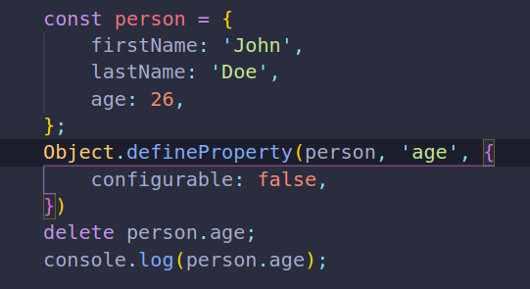
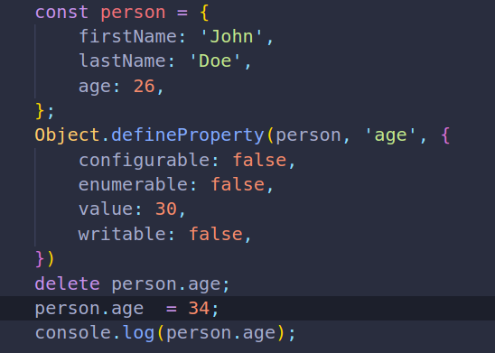
Object properties and methods cont…
Data Properties
Output
Output

Slide 26
Object properties and methods cont…
Accessor Properties
similar to data properties, accessor properties also have [[Configurable]] and [[Enumerable]] attributes. But the accessor properties have the [[Get]] and [[Set]] attributes instead of [[Value]] and [[Wirtable]].
When you read data from an accessor property, the [[Get]] function is called to return a value. The default return value of the[[Get]] function is undefined .
If you assign a value to an accessor property, the [[set]] function is called. To define an accessor property, you must use the Object.defineProperty() method

Slide 27
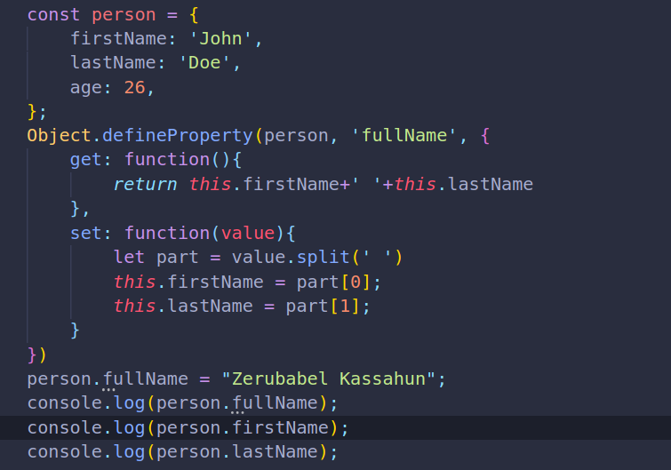

Object properties and methods cont…
Accessor Properties
Output:

Slide 28
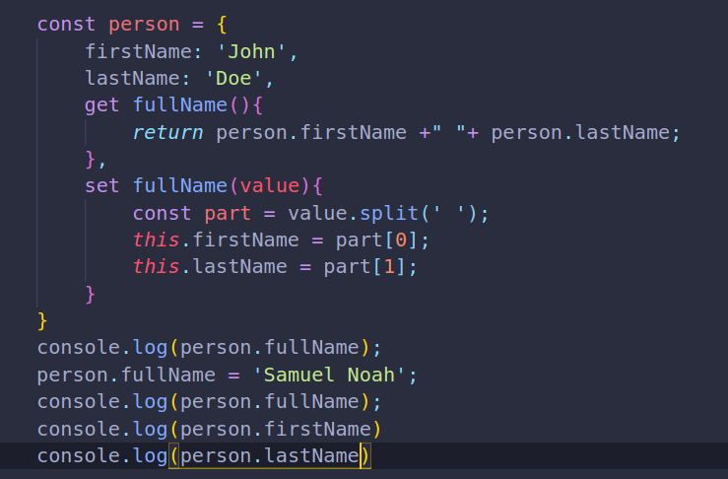

Object accessors
Output:

Slide 29
Object constructors and Prototype
Object Constructor
Instead of creating individual objects, what if we wanted to create several instance objects from a single “Blueprint” object? This is when constructor functions come into play.
Constructor - is a function used to create instance objects with the new keyword.
When you call a constructor, it will:
create a new object
bind this to the new object, so you can refer to this in your constructor code
run the code in the constructor
return the new object.

Slide 30
Object constructors and Prototype
Person
var Jim
name
Jim
age
25
introduceMySelf()
var Pam
introduceMySelf()
Pam
24
introduceMySelf()

Slide 31
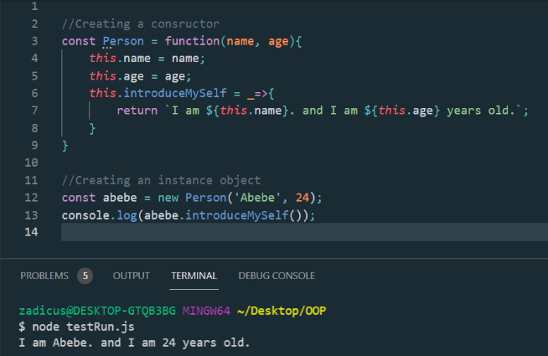
Object constructors and Prototype
We are creating an “abebe” object from the constructor “Person” having the attributes “name”, “age” and a method “intruduceMySelf”.
Can you think of another way of creating an instance object from an Object?

Slide 32
Object constructors and Prototype Cont…
The “new” keyword is used to create an instance of an object that has a constructor function. On calling the constructor function with ‘new’ operator, the following actions are taken:
Can anyone explain the “this” keyword function?
A new empty object is created.
The new object’s internal ‘Prototype’ property (__proto__) is set the same as the prototype of the constructing function.
The ‘this’ variable is made to point to the newly created object. It binds the property which is declared with ‘this’ keyword to the new object.
A newly created object is returned when the constructor function returns a non-primitive value (custom JavaScript object). If the constructor function returns a primitive value, it will be ignored. At the end of the function, ‘this’ is returned if there is no return statement in the function body.

Slide 33
Object constructors and Prototype Cont…
Prototype
JavaScript is a prototype based language, so, whenever we create a function using JavaScript, JavaScript engine adds a prototype property inside a function, Prototype property is basically an object (also known as Prototype object), where we can attach methods and properties in a prototype object, which enables all the other objects to inherit these methods and properties.
When we create an object using function constructor, JavaScript Engine will add dunder proto or __proto__ in the object which will point to the prototype’s constructor object.

Slide 34
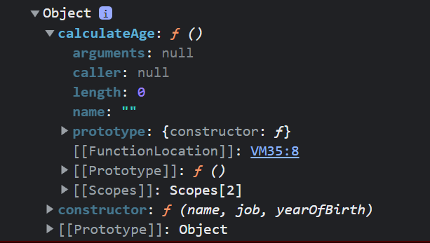
Object constructors and Prototype Cont…
Output
// function constructor
const Person = function(name, job, yearOfBirth){
this.name= name;
this.job= job;
this.yearOfBirth= yearOfBirth;
}
Person.prototype.calculateAge= function(){
console.log('The current age is: '
+(2019- this.yearOfBirth));
}
console.log(Person.prototype);

Slide 35
Practical Exercises
What do you think the output for the following piece of code and Why?:
// function constructor
const Person = function(name){
this.name= name;
}
Person.prototype.nationality = "Russian";
const John = new Person("John");
console.log(John__proto__.nationality);
const Abera = new Person("Abera");
Abera.__proto__.nationality = "Ethiopian";
console.log(Abera.__proto__.nationality)
console.log(John.__proto__.nationality);

Slide 36
Practical Exercises
TASK 1:
-Create a web page with two buttons “TakeOff” and “Land”, and an empty text field area.
- Write an Airplane constructor that initializes `name` from an argument.
- All airplanes built with Airplane should initialize with an `isFlying` of false.
- Give airplanes the ability to `.takeOff()` and `.land()`:
+ If a plane takes off, its `isFlying` property is set to true.
+ If a plane lands, its `isFlying` property is set to false.
When the takeOff button is clicked, “IsFlying = True” should be rendered to the empty text area in the web page created.
When the Land button is clicked, “IsFlying = False” should be rendered to the empty text area in the web page created.

Slide 37
Solution for Task 1
<!doctype html>
<html>
<head><title>Lab Exercies</title></head>
<body>
<button id=”takeOffBtn”>TakeOff</button>
<button id=”landBtn”>Land</button>
<div id=”textField”></div>
<script src=”./app.js”></script>
</body>
</html>
TakeOff
Land
Text Area

Slide 38
Solution for Task 1
function Airplane(name) {
this.name = name;
this.isFlying = false;
}
Airplane.prototype.takeOff = function() {
this.isFlying = true;
};
Airplane.prototype.land = function() {
this.isFlying = false;
};
Airplane boing = new Airplane(“Boing”);

Slide 39
Solution for Task 1
const takeOffBtn = document.querySelector(“#takeOffBtn”);
takeOffBtn.onclick = function(){
boing.takeOff();
document.querySelector(“#textArea”).innerText = `IsFlying = ${boing.isFlying}`;
}
const landBtn = document.querySelector(“#landBtn”);
landBtn.onclick = function(){
boing.takeOff();
document.querySelector(“#textArea”).innerText = `IsFlying = ${boing.isFlying}`;
}

Slide 40
Solution for Task 1
TakeOff
Land
TakeOff
Land
IsFlying = True
IsFlying = False

Slide 41
Practical Exercises
TASK 2
- Write a Person Constructor that initializes `name` and `age` from arguments.
- All instances of Person should initialize with an empty `stomach` array.
- Give instances of Person the ability to `.eat("someFood")`:
+ When eating an edible, it should be pushed into the `stomach`.
+ The `eat` method should have no effect if there are 10 items in the `stomach`.
- Give instances of Person the ability to `.poop()`:
+ When an instance poops, its `stomach` should empty.
- Give instances of Person a method `.toString()`:
+ It should return a string with `name` and `age`. Example: "Mary, 50"

Slide 42
Solution for Task 2
function Person(name, age) {
this.name = name;
this.age = age;
this.stomach = [];
}
Person.prototype.eat = function(food) {
if (this.stomach.length < 10) {
return this.stomach.push(food);
} else {
return `I can't eat anymore`;
}
};
Person.prototype.poop = function() {
return (this.stomach = []);
};
Person.prototype.toString = function() {
return `${this.name}, ${this.age}`;
};

Slide 43
Practical Exercises
TASK 3
- Create a web page with a form or you can use the register page from activity 4.
- Write a javascript program that creates an object and sets its values from the web page form input.
- Render the object back to the web page.

Slide 44
Solution
function Register() {
this.fullName = document.getElementById('fullname').value;
this.phone = document.getElementById('phone').value;
this.age = document.getElementById('age').value;
this.introduceMySelf = () => {
parent = document.getElementById('render');
const div = document.createElement('div');
div.classList.add('appended');
div.innerHTML = `<h1>New Added Form</h1><h1>Full Name: ${this.fullName}</h1><h1>Age: ${this.age}</h1><h1>PhoneNo.: ${this.phone}</h1>`;
parent.appendChild(div)
}
}
const callBack = () => {
const newObject = new Register();
newObject.introduceMySelf()
}
document.getElementById('submitBtn').addEventListener('click', callBack);

Slide 45

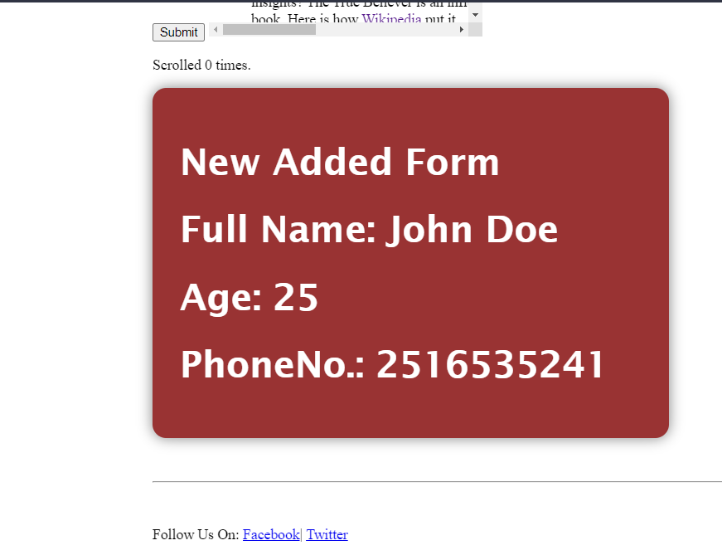
Solution
Output

Slide 46
Inheritance and Prototype chain
When it comes to inheritance, JavaScript only has one construct: objects. Each object has a private property which holds a link to another object called its prototype. That prototype object has a prototype of its own, and so on until an object is reached with null as its prototype. By definition, null has no prototype, and acts as the final link in this prototype chain.
function Person(firstName, lastName)
{
this.FirstName = firstName || "unknown";
this.LastName = lastName || "unknown";
};
Person.prototype.getFullName = function () { return this.FirstName + " " + this.LastName; }
Now any objects instantiated from the “Person” constructor will inherit the properties and methods inside the “Person” object.
All objects are an instance of the “Object” object. This is the last object in the prototype chain before the Null prototype object. Therefore, all objects created in javascript inherit the methods and properties pre-defined in the “Object” object.

Slide 47
Practical Exercises
Can an inherited method from the “Object” class be modified?
What do you think the output of the following code will be:
function Dog(name) {
this.name = name;
this.speak = function() {
return 'woof';
};
}
const dog = new Dog('Pogo');
Dog.prototype.speak = function() {
return 'arf';};
console.log(dog.speak());

Slide 48
1. Traverse objects
what it mean traverse objects?
looping through objects .
The various methods that can be used to loop through objects in JavaScript are
Using a for...in loop
Object.keys method
Object.values method

Slide 49
1. Traverse objects
Methods to loop through objects using javascript
1.Using a for...in loop
The most straightforward way to loop through an object's properties is by using the for...in statement
function person (name,age){
this.name=name;
this.age=age;
}
var b=new person("Abebe",12);
for (const key in b) { // iterate over the user object
console.log(`${key}: ${b[key]}`);
}
// name: Abebe
// age: 12

Slide 50
1. Traverse objects
One problem in using the for...in method is that it loops through the properties in the prototype chain as well. Since the objects in JavaScript can inherit properties from their prototypes, the for...in statement will loop through those properties as well.but to avoid this problem, you have to explicitly check if the property belongs to the object by using the hasOwnProperty() method. example:
function person (name,age){this.name=name;
this.age=age;}
var b=new person("Abebe",12);
person.prototype.bloodColor="red";
for (var key in b) {
//if(person.hasOwnProperty(key);
console.log(`${key}: ${b[key]}`);
}// name: Abebe // age: 12 //bloodColor:red

Slide 51
1. Traverse objects
Methods to loop through objects using javascript
1.Object.keys() Method :-
It takes the object that you want to loop over as an argument and returns an array containing all properties names (or keys)
function person (name,age){
this.name=name;
this.age=age;
}
var Abebe=new person("Abebe",12);
const keys = Object.keys(Abebe);
person.prototype.bloodColor="red";
keys.forEach(function(index){
console.log(`${index}: ${Abebe[index]}`);
});
// output name: Abebe age: 12

Slide 52
1. Traverse objects
Methods to loop through objects using javascript
1.Object.values() Method :-
It takes the object that you want to loop over as an argument and returns an array containing all properties names (or keys)
function person (name,age){
this.name=name;
this.age=age;
}
var Abebe = new person("Abebe", 12);
Object.values(Abebe).forEach(function (val){
console.log(val)});
// output name: Abebe age: 12

Slide 53
Reading Resources/Materials
Links
https://www.geeksforgeeks.org/
https://developer.mozilla.org/en-US/
https://www.w3schools.com/

Slide 54

Thank You
For Your Attention!!

